Slide 1
ITLG311 - Business Communication
Faculty of ICT, Mahidol University
Semester 1, 2026-27
Session 04: Digital Communications

Slide 2
Previously:
Fundamentals of Writing for Business Purposes:
Understand the purpose and goals of the course, lesson/unit structures, and evaluation formats.
Recognize basics of writing for business purposes, and how it differs from other purposes of communication.
Focus On Audience, Tone and Function:
Identify the audience and purpose
Internal and external messages
Choose the right information
Adapt tone and level of formality
Structure a clear business email
Write short and longer messages
Check readability

Slide 3
Homework/Feedback:

Slide 4
This Week:
Objectives:
Identify the main digital tools used for internal/external business communication.
Discuss the characteristics of engaging content (including social media)
Put it together
1. Types of Digital Messaging Platforms
2. Using Digital Platforms
3. Adapting the message for different platforms
4. Responding to Digital Messages
5. Practice

Slide 5
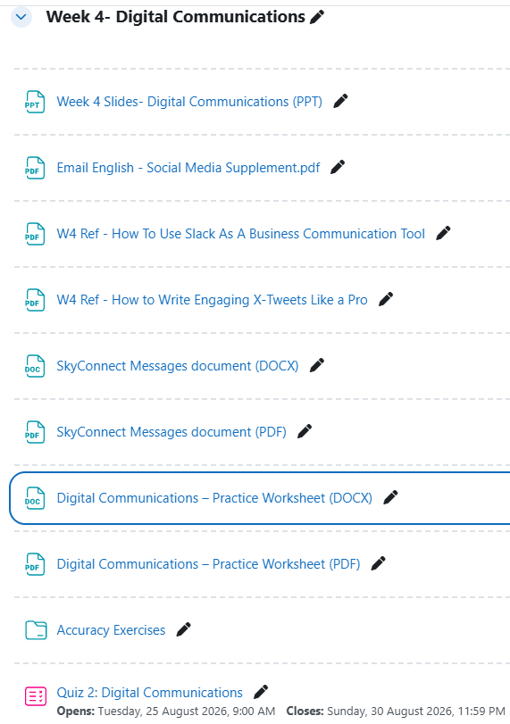
Today’s Reference Materials/Resources

Slide 6
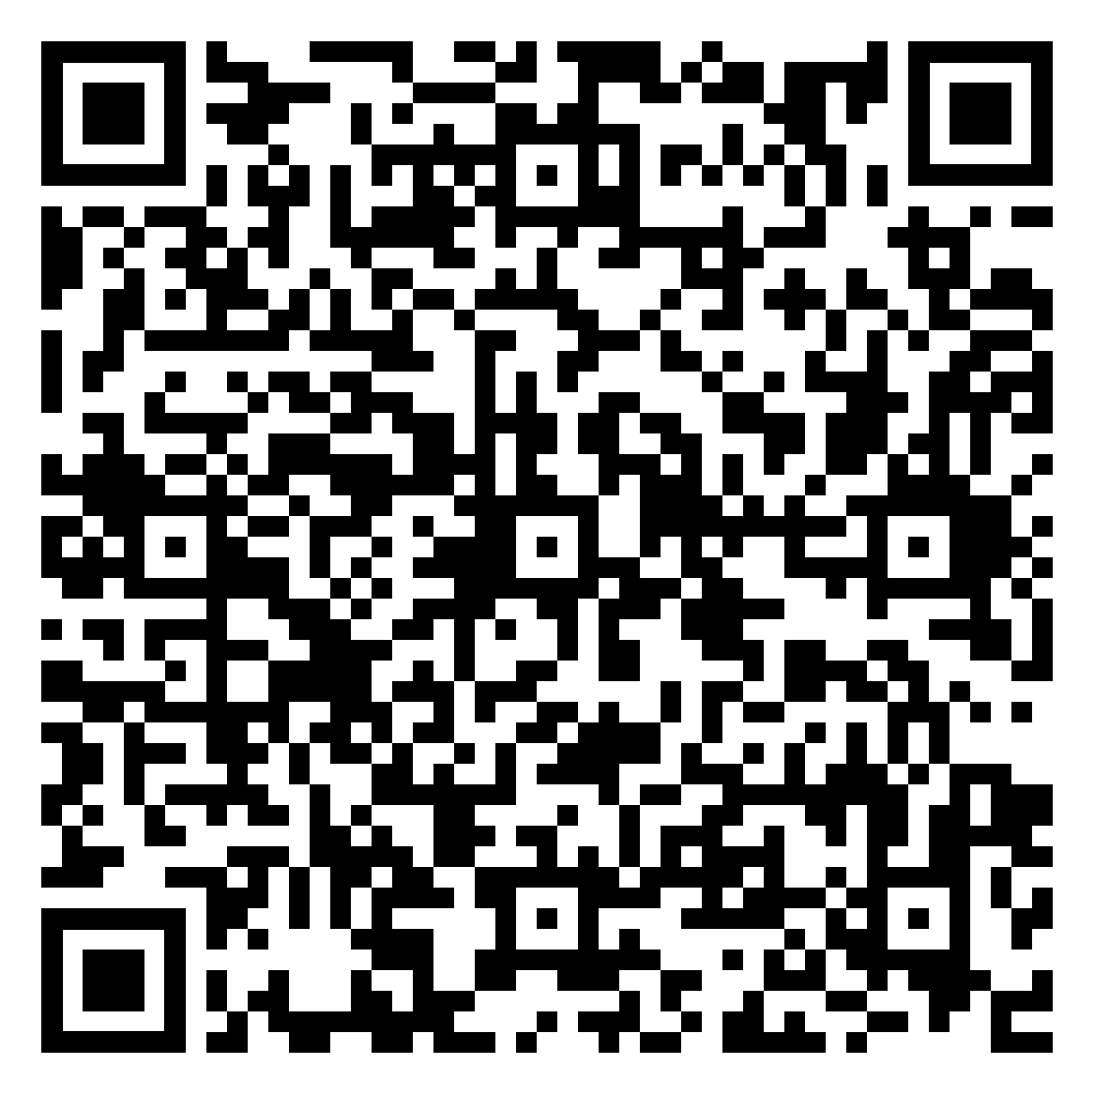

Messaging Types
What are the most common ways we transmit messages?
List as many communication methods/platforms as possible and categorize them:
Today we are interested specifically in Digital Forms of message types
Low-tech/No-tech
Digital
Letter, conversation, email, phone call
Line, Facebook, Instagram, whatsapp, X, wechat

Slide 7
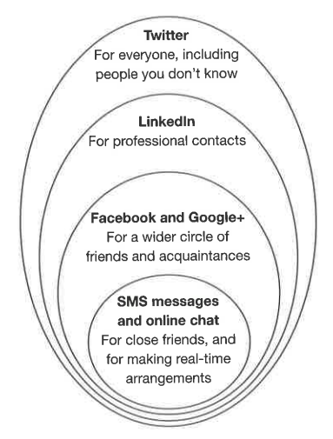
1. Types of Digital Messaging Platforms
SMS
Instant Messages/Chat
Social Media:
Facebook
Twitter/X
Instagram
LinkedIn
Emails
Message Complexity
The complexity/function of the message influences the method of communication, which also usually relates to the level of formality

Slide 8
1.1: Instant Messaging
Often used to Internal teams, customer support, client communication.
Quick, informal conversations.
Perfect for customer service, and real-time collaboration.
Allows for Instant Communication, which is essential for speeding up decision-making.
Excellent if used appropriately within small teams
Problematic if overused, or difficult to track large teams/large projects
Lack of formality can be distracting and may lead to misunderstandings

Slide 9
1.1: Instant Messaging (Extended)
A range of Professional Business Communications Applications are available that mainly focus on use of Instant Messaging/Chat functions:
MS Teams
Slack
WebEx
While each app has additional functions, such as video-communications and file/screen sharing, we need to focus on the Chat Functions

Slide 10
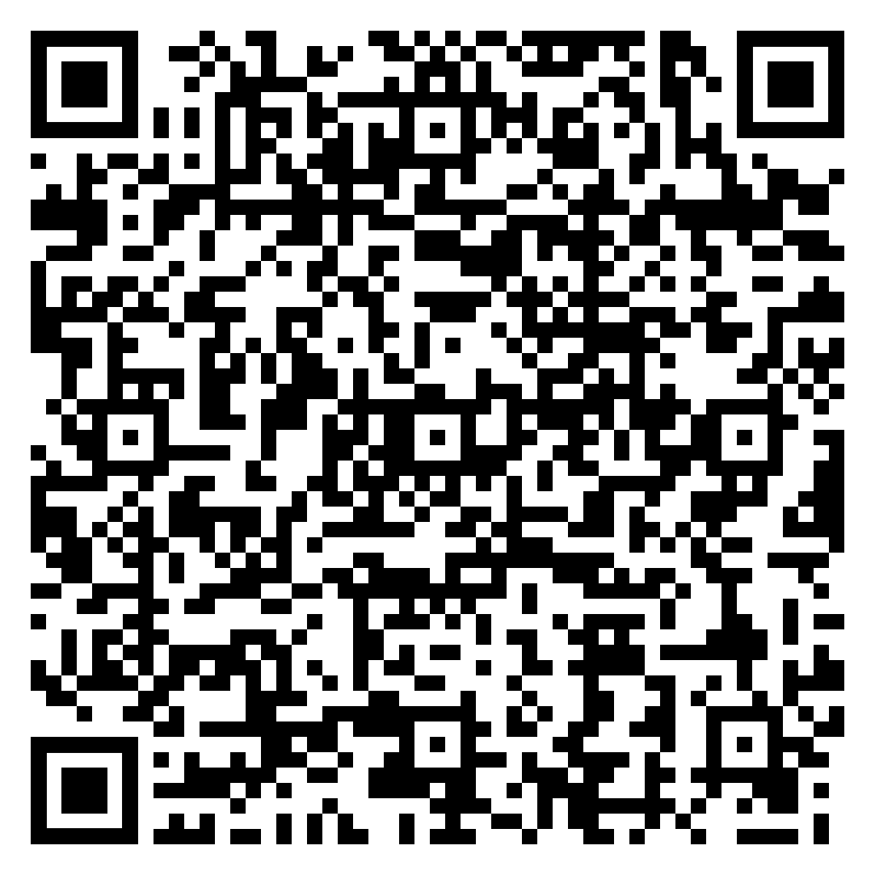
1.1: Professional Messaging Platforms
Professional Messaging platforms are not just Chat applications – they extend functionality through expanded connectivity
It is important to set clear ground-rules for the use of platforms such as Slack:
Create job-function related channels for each team or situation
Be very selective how to define Private and Public channels
Platforms such as Slack can cross-integrate, so make use of its functionality
Encourage participation: On-site or Off-site through Shared Media
Much more:

Slide 11
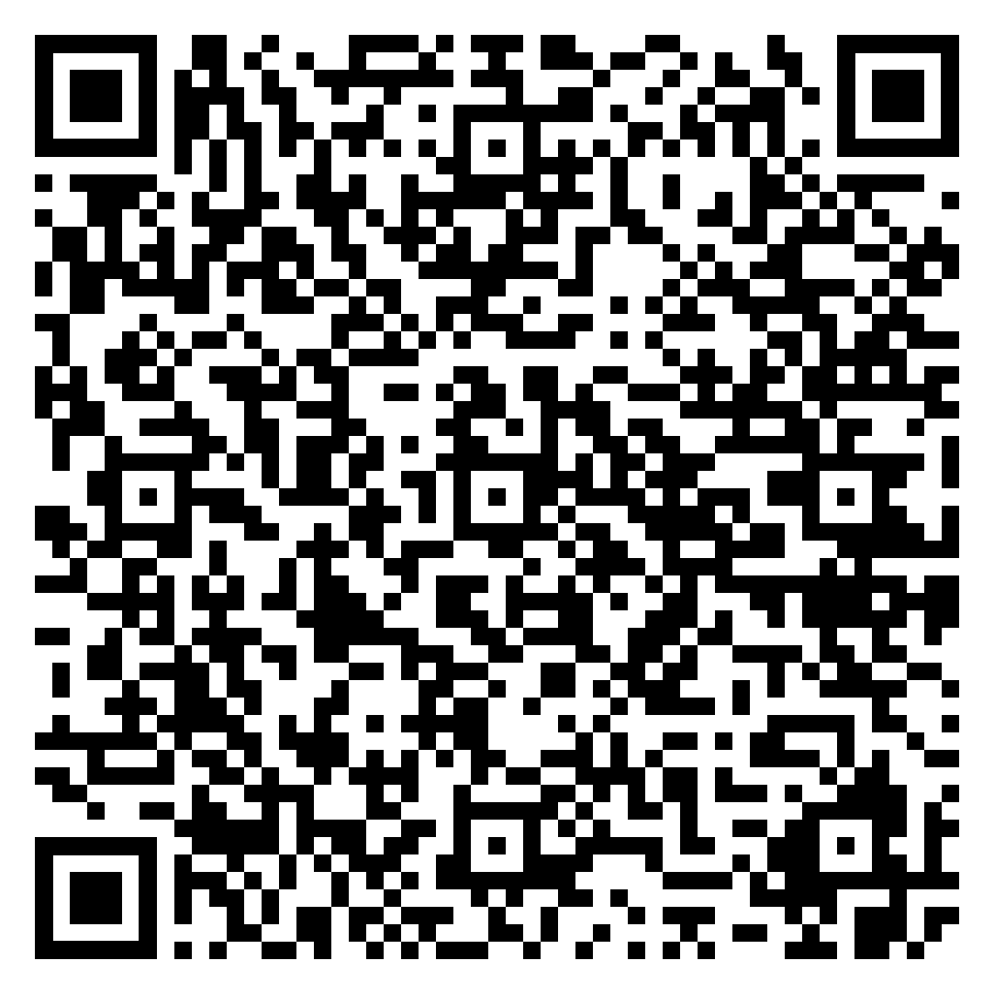

1.2: Social Media
In business contexts, the audience of Social Media is General public, potential customers, community members
Useful for brand awareness, customer engagement, event promotion, customer service.
Quick engagement through posts, comments, and reposts, and use of icons
Broad audience reach, community engagement, and useful analytics
Hashtags are powerful for targeting trends.
Trends can change very quickly
High-risk of instantaneous negative feedback with immediate impact
Time-consuming to maintain creative engagement strategies

Slide 12
1.3: Emails
Used in business to communicate with Clients, colleagues, stakeholders, customers
Used for Formal communication, marketing, newsletters, documentation
Follows a clearly identifiable format:
  Subject Line, Message Body (Opening, Main Message, Action, Closing)
Effective for providing detailed information and highly versatile for different situations. Easily scalable for mass marketing
Can be easily overlooked (inbox clutter)
Potential for being marked as spam
Requires careful crafting to avoid miscommunication

Slide 13
1.4: Website Press Releases
Used in business to communicate with Clients, colleagues, stakeholders, customers
Used for Formal communication, marketing, newsletters, documentation
Keeps clients informed about updates, products, or services
Strengthens brand loyalty through regular, reliable communication
Builds trust by sharing useful, relevant information consistently
Supports long-term relationships through personalized and targeted content

Slide 14
2: Using Digital Platforms
Not only the message/idea is important, but also the manner in presenting it via the appropriate format:
The format of a message affects how we present information.
  Short messages
  Longer messages
When would a businessperson choose a short message?
  When the density of information is less.
When would a longer message be more appropriate?
  When the details of the idea can help receiver to better understand.
Is a longer message always better?
  No one type of message can be used in every situation.
If you are sending a quick message to a colleague, do you need a full explanation?
  Mostly don’t, but if the colleague unknow about the context, it will be necessary to add details.
What happens to language when we need to communicate quickly?
  Use short phase, concise vocabulary, and straight to the point.
If the reader needs several pieces of information, how could you make the message easier to read?
  Use long message format, use formal tone, clear and precise vocabulary.

Slide 15
3: Adapting the message for Various Platforms
The key considerations of message length highlight the different priorities and strategies required for effective communication depending on the platform used and the purpose of the digital message.
The Same Principles, Different Platforms
Email → more detail and structure
Chat/Instant Messages → short, direct, immediate
Social media → public, engaging, audience-focused
Website/press release → formal, informative, wider audience

Slide 16
4: Responding to Digital Messaging
Q: Why do you think responses to Digital Communication are important?
Q: How can/should you respond appropriately?
Notes:
How to Respond to Digital Messages
1. Acknowledge Receipt Promptly:
Why: Timely acknowledgment shows that you’ve received the message and are engaged. It reassures the sender that their communication has reached you.
How: Even if you can’t provide a full response immediately, send a brief note like, “Got it, I’ll get back to you shortly” or “Thanks for the update.”
2. Understand the Context:
Why: Responding appropriately requires understanding the context, urgency, and tone of the original message.
How: Read the message carefully, considering who sent it, the purpose, and the platform (e.g., email vs. instant message). If unclear, don’t hesitate to ask for clarification.
3. Match the Tone:
Why: Matching the sender’s tone helps maintain rapport and ensures that your response is appropriate for the situation.
How: For formal messages, use a professional tone. For informal platforms, a more casual tone may be acceptable. Always be polite and respectful.
4. Be Clear and Concise:
Why: Clear communication minimizes misunderstandings and ensures that your response is understood the first time.
How: Get straight to the point, answer questions directly, and avoid unnecessary jargon. If more detail is needed, structure your response to be easy to follow.
5. Provide Next Steps or a Closing Statement:
Why: Clear next steps or a summary at the end of your message ensures that both you and the recipient know what comes next.
How: Include phrases like, “Please confirm,” “Let me know if you have any questions,” or “Looking forward to your feedback.”
Why Responding to Digital Messages is Important
1. Maintains Professionalism:
Why: Responding in a timely and appropriate manner reflects well on your professionalism and reliability.
How: Regularly check your messages and prioritize responses based on urgency and importance.
2. Fosters Clear Communication:
Why: Regular and clear communication prevents misunderstandings, builds trust, and facilitates smooth collaboration.
How: Always respond with clarity, even if it’s just to confirm receipt or agree on a follow-up.
3. Builds Relationships:
Why: Consistent and thoughtful communication helps strengthen professional and personal relationships.
How: Show appreciation for messages, respond to inquiries thoughtfully, and offer help when needed.
4. Demonstrates Respect:
Why: Responding to messages shows respect for the sender’s time and effort, reinforcing mutual respect in communication.
How: Even if the message doesn’t require a detailed response, a quick acknowledgment shows that you value the communication.
5. Ensures Efficiency:
Why: Quick and effective responses help keep projects and conversations moving forward, avoiding delays.
How: Prioritize messages based on deadlines, importance, and the sender’s expectations.

Slide 17
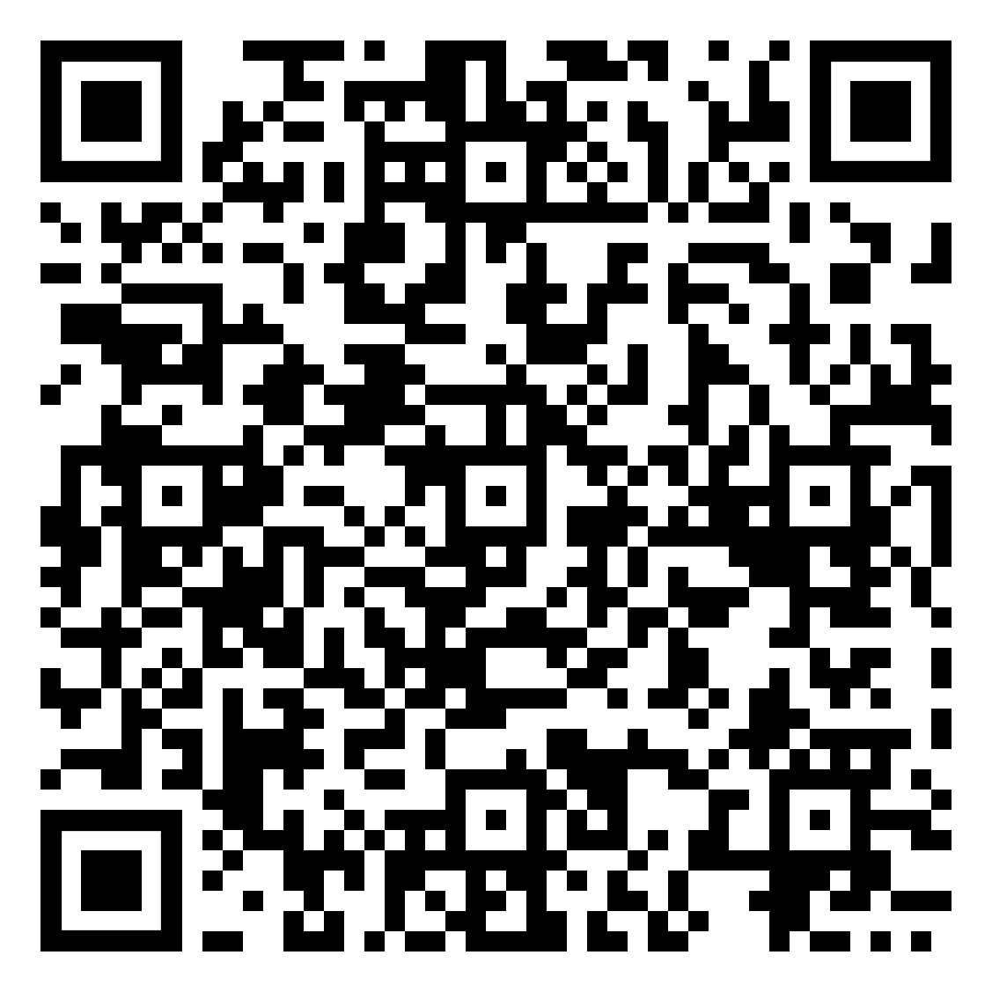
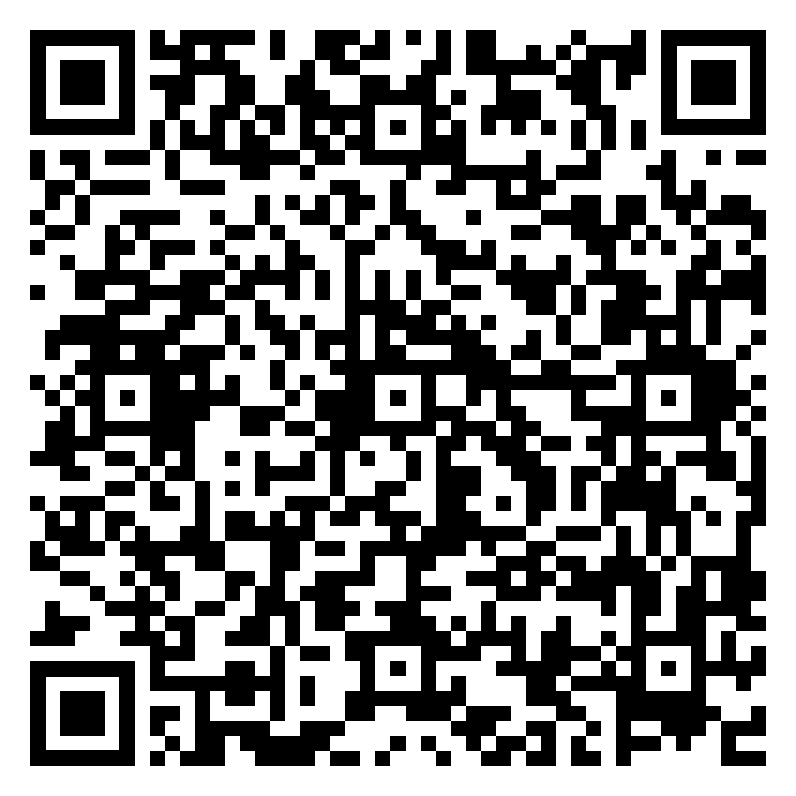

5. Activity: Examples of Digital Communications
Instructions:
You are about to see an example situation that requires communication across a range of platforms, followed by some samples of digital communication methods.
In pairs, as you review each message, try to recognize the:
Primary Audience
Main purpose/reason for communicating
Tone/Level of formality
Level of detail
Intended outcome of the message

Slide 18
5.1: Scenario: Internet Service Disruption
Company Name: SkyConnect Internet Co., Ltd.
Location: Chiang Mai, Thailand
Date: August 18, 2025
Background: SkyConnect is a leading internet service provider (ISP) in northern Thailand, serving both residential and business customers. On August 17th, a major underground fiber-optic cable was accidentally damaged during a city construction project near the main network hub.
The Situation: As a result of the damage, a significant portion of SkyConnect’s customers—especially in central Chiang Mai and surrounding districts—are experiencing total loss of internet service. Emergency repair teams have assessed the situation and estimate that full restoration will take up to 7 days due to the complexity of the underground infrastructure and the need for imported replacement parts.
Negative News to Communicate: Customers must be informed that internet service will be disrupted for the next 7 days, and that the company is working around the clock to resolve the issue.

Slide 19
6. Accuracy Matters
What does accuracy mean?
Definition: Ensuring that all information presented is correct, precise, and free of errors
Why is accuracy important?
Professionalism:
Clarity:
Trust:
Efficiency:
Reputation:
Decision Making:
Inaccuracies can lead to costly mistakes, misunderstandings, and damage to relationships and the organization's reputation
Notes:
Accuracy in Business Writing
Ensuring that information is correct, precise, and free of errors.
This is crucial because:
Professionalism: Accurate writing reflects well on the writer and the organization, showing attention to detail and care in communication.
Clarity: Accurate information prevents misunderstandings and ensures that the message is clear and unambiguous.
Trust: Maintaining accuracy builds trust with clients, colleagues, and stakeholders, as they can rely on the information provided.
Efficiency: Reduces the need for follow-up questions or corrections, saving time and resources.
Legal Compliance: Ensures that all communications comply with legal and regulatory requirements, minimizing risks of legal issues.
Reputation: Protects and enhances the reputation of the business by demonstrating reliability and competence.
Decision Making: Provides a solid foundation for making informed business decisions based on accurate and reliable information.
Inaccuracies can lead to costly mistakes, misunderstandings, and damage to relationships and the organization's reputation.

Slide 20
6.1 How can you be more accurate?
To improve accuracy in formal writing:
Proofreading:
Reference Materials:
Practice, Practice, Practice:
Planning and Outlining:
Notes:
Proofreading: Carefully review the text for spelling, grammar, punctuation, and formatting errors. Use tools like spell checkers and grammar checkers, but also manually proofread to catch mistakes these tools might miss.
Use Reference Materials: Keep a dictionary, thesaurus, and grammar guide handy to check for correct word usage and grammatical structures. Reliable online resources can also be helpful.
Practice Formal Writing: Regularly practice writing formal emails, reports, and letters. Pay attention to structure, tone, and vocabulary. Seeking feedback from teachers or native speakers can be beneficial.
Plan and Outline: Before writing, plan and outline your content. Organize your ideas logically, and ensure each point is clear and supported. This helps in creating a coherent and accurate piece of writing.

Slide 21
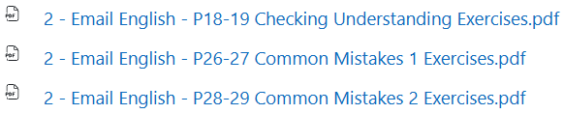
6.2 Test your accuracy:
Consider aspects of language such as:
Word Order
Verb Form
Sentence Building
Missing Words/Details
Checking Understanding
Common Mistakes
Notes:
Select activities as necessary:
Email English: The Basics
P18-19: Word Order
P20-21: Verb Form
P22-23: Sentence Building
P24-25: Missing Words
Email English:
P18-19: Checking Understanding
P26-27: Common Mistakes 1
P28-29: Common Mistakes 2

Slide 22
7. Technical Language and Audience
Many IT professionals use highly technical terms that general users don’t understand.
However, when you send messages, non- technical people like new employees or customers should be able to follow them.
Technical audience: knows the tools and terms.
Non-technical audience: needs to understand the action or purpose without background knowledge.
How to make terms less technical:
  Avoid acronyms
  Use simple familiar verbs
    Turn off- turn on- reboot- install- restart- reboot- send- release, etc)
  Explain the purpose/ function or effect

Slide 23
7.1 Technical vs Non- Technical Examples
Technical version 1
The IT team will deploy the patch via the CI/CD pipeline.
Non-technical version options:
The IT team will send the software update to users automatically.
The IT team will install the latest fix using the update system.
The IT team will release the new version through the company's update tool.
Technical version 2
The IT team will restart the Apache service.
Non-technical version options:
The IT team will turn the web server off and on again.
The IT team will restart the program that runs the website.
The IT team will reboot the system that delivers web pages.

Slide 24
7.2 Technical vs Non- Technical Exercise
Imagine you are explaining this to a new employee with no technical background. Rewrite each sentence using clear, familiar non- technical language.
The IT team will configure the DNS settings on the local network.
  The IT team will configure the network settings.
The IT team will migrate user data to the cloud server.
  The IT team will upload the user data to the server.
The IT team will update the SSL certificate before it expires.
  The IT team will update the website certificate before it expires.
The IT team will grant admin privileges to the new account.
  The IT team will set up a new manager account.
The IT team will install dependencies using the package manager.
  The IT team will install the files that the system/application require.

Slide 25
Key Takeaways:
Before you send a message, ask:
WHO?
Who will read it?
WHY?
What do I want the reader to know or do?
WHERE?
Which platform is appropriate?
HOW?
How much information and what tone are appropriate?
CHECK
Is it accurate, clear and easy to read?

Slide 26
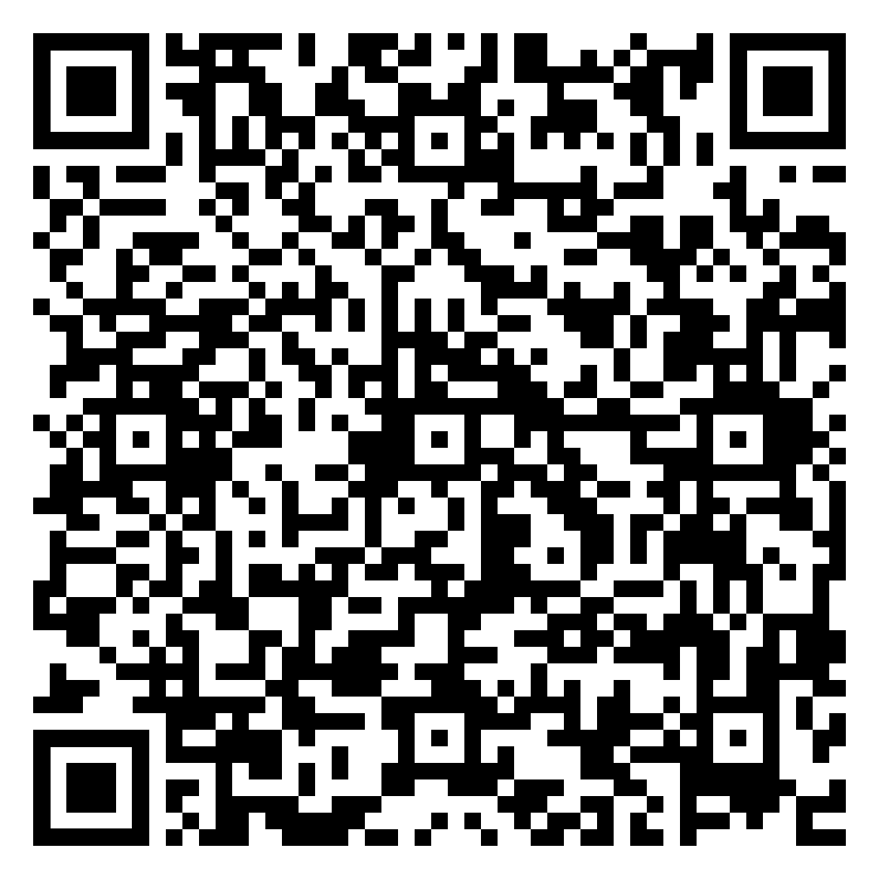
Activity: Now You Try It
Task: Plan and create all of the necessary communication to a variety of audiences, across a range of platforms:
NexonTech’s ticketing system is down. Repairs will take 3–4 hours.
1. EMPLOYEES – Email
Improve the IT Manager’s message.
2. SENIOR MANAGEMENT – Send an Email saying:
What happened
Repair time
Impact
What happens next
3. EMPLOYEES – Teams
Write a short restoration message and include:
System restored + time
What employees should do
Who to contact if there are problems

Slide 27

NOTICE 1:
MyCourses Quiz 2: Unit 2 – Digital Communications
Digital Communication Theory (Including Social Media)
Fundamental Business Vocabulary/Phrasing
Message Format/Organization
Quiz Conditions:
Quiz 2 will close at 23:59, Sunday 30 August 2026
Only one attempt allowed
One hour (60 minutes) time limit
Be sure to review lesson notes and Week 3 and 4 resources before your attempt
GOOD LUCK!

Slide 28
NOTICE 2:
Week 5: Formal Evaluation - Assessment 1
What will you do?
Complete an in-class business communication writing task
Use appropriate audience, purpose, tone and message format
Plan and Write clear, accurate and readable business messages for the correct platform
You will have 2 hours to complete the assessment
Bring: pen / pencil / eraser
An English-to-English paperback dictionary is allowed
You may NOT use:
Mobile phones or other devices
The Internet
AI tools
Class notes
Other sources or assistance

Slide 29
Congratulations on surviving another class
THANK YOU for your participation today
Have a great week everyone!
See you next week
Until then, Take Care & Stay Safe
Finally….

